Slide 1
How to use this template
Step 1: Set Up the PowerPoint Template
This template helps create backgrounds for Brilliant Assessments that look polished and professional.
Step 2: Set Up the Background
Right-click on the slide and select Format Background.
Choose a background option, such as Solid, Gradient, or Picture Fill.
Step 3: Adjust the Template Transparency
Adjust the transparency of the template to see your background while keeping the template overlay visible as a guide.
For newer Office versions head to Picture tools format> Transparency, for older versions, head to Format shape>Fill> Picture fill.
Step 4: Add Text for Your Background
  Go to Insert > Text Box and add text
  Rotate the text vertically (90° or 270°) to avoid text cutting off on smaller screens.
Step 5: Insert Images and Shapes
Add Shapes: Use PowerPoint shapes to create design elements: Go to Insert > Shapes, and choose shapes (e.g., arrows, stripes).
Add Image Fill: Go to Shape Format > Shape Fill > Picture and select an image (e.g., download from Unsplash). Resize the shape as needed and remove the outline for a clean look.
Step 6: Group and Arrange Elements
Select the shapes you want grouped together, right-click, and select Group. This keeps your design intact and aligned.
Step 7: Export the Slide
Once finished, select the slide and go to File > Export.
Choose PNG format, select Save Current Slide Only.
Set the resolution to 2250 x 1250 pixels if needed.
Step 8: Upload to Brilliant Assessments
In Brilliant Assessments, go to Settings > Design.
Select Upload Image under Background options, find your saved file, and upload it.
Save the design, and refresh your assessment to test how it appears.
Step 9: Final Check
Check the background across different screen sizes to ensure responsiveness. Make tweaks if needed.
This guide should give you a polished background for Brilliant Assessments.
Enjoy creating!

Slide 2
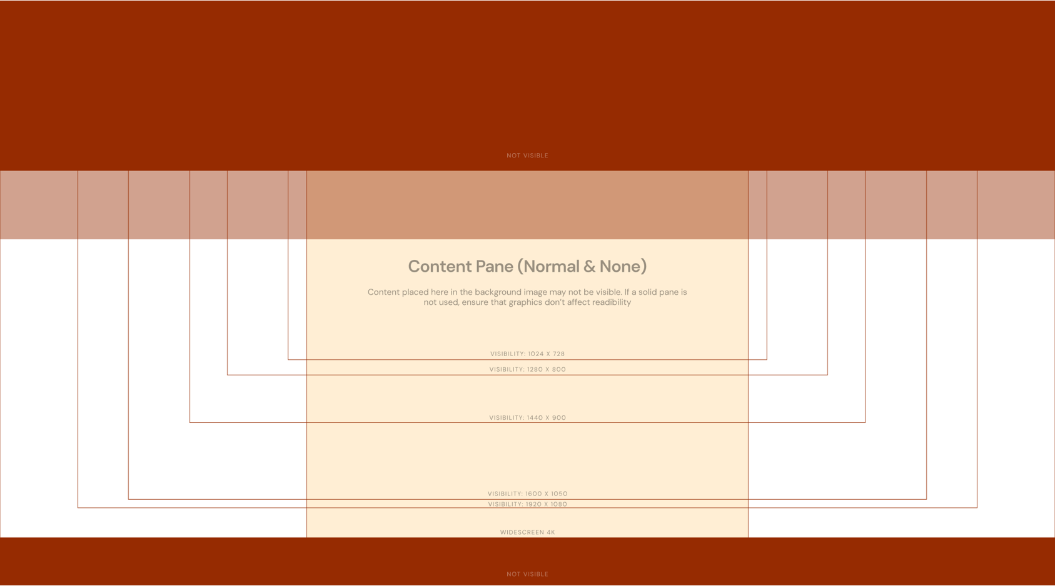

Slide 3
